Slide 1
Chapter 6

Slide 2
Objectives

Slide 3
Objectives (cont.)

Slide 4
Common server controls

Slide 5
List server controls

Slide 6
When to use HTML elements instead of server controls

Slide 7
Common control events

Slide 8
A Click event hander

Slide 9
A Load event handler that changes the data in server controls

Slide 10
A method that gets data from controls and puts them into a Customer object

Slide 11
The form properties for setting the focus and default button

Slide 12
The control properties for setting the tab order and access keys

Slide 13
The aspx code for a form

Slide 14
Common label properties

Slide 15
Common text box properties

Slide 16
TextMode values for the HTML5 type attributes for input elements

Slide 17
The aspx for a label and a multiline text box

Slide 18
Common check box and radio button properties

Slide 19
The aspx code for the three check boxes

Slide 20
The aspx code for the two radio buttons

Slide 21

The check boxes and radio buttons in a browser

Slide 22
Common image properties

Slide 23
Common hyperlink properties

Slide 24
A property of the file upload control

Slide 25
A label, file upload control, and button control in a browser

Slide 26
The Click event handler for the button control

Slide 27
Common properties for Button, LinkButton, and ImageButton controls

Slide 28
Button, LinkButton, and ImageButton controls

Slide 29
An event handler for the Click event of a button control

Slide 30
Properties of the CommandEventArgs class

Slide 31
Four buttons in a browser

Slide 32
An event handler for the Command events of the buttons

Slide 33
Common properties of list box controls

Slide 34
The aspx for a list box

Slide 35
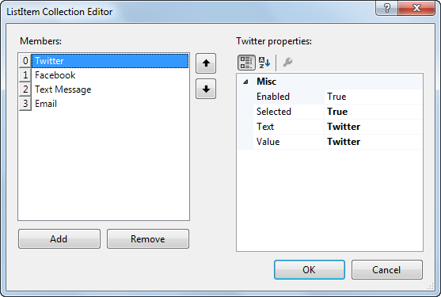
The Collection Editor for creating and editing lists

Slide 36
Common properties of list controls

Slide 37
The aspx code for a drop-down list

Slide 38
Code that gets the value of the selected item in the drop-down list

Slide 39
Common property of a list control

Slide 40
Common methods of a ListItemCollection object

Slide 41
C# code that loads items into a drop-down list using strings

Slide 42
Properties for formatting radio button and check box lists

Slide 43
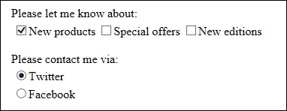
A check box list and a radio button list in a browser

Slide 44
The aspx code for the check box list

Slide 45
The aspx code for the radio button list

Slide 46
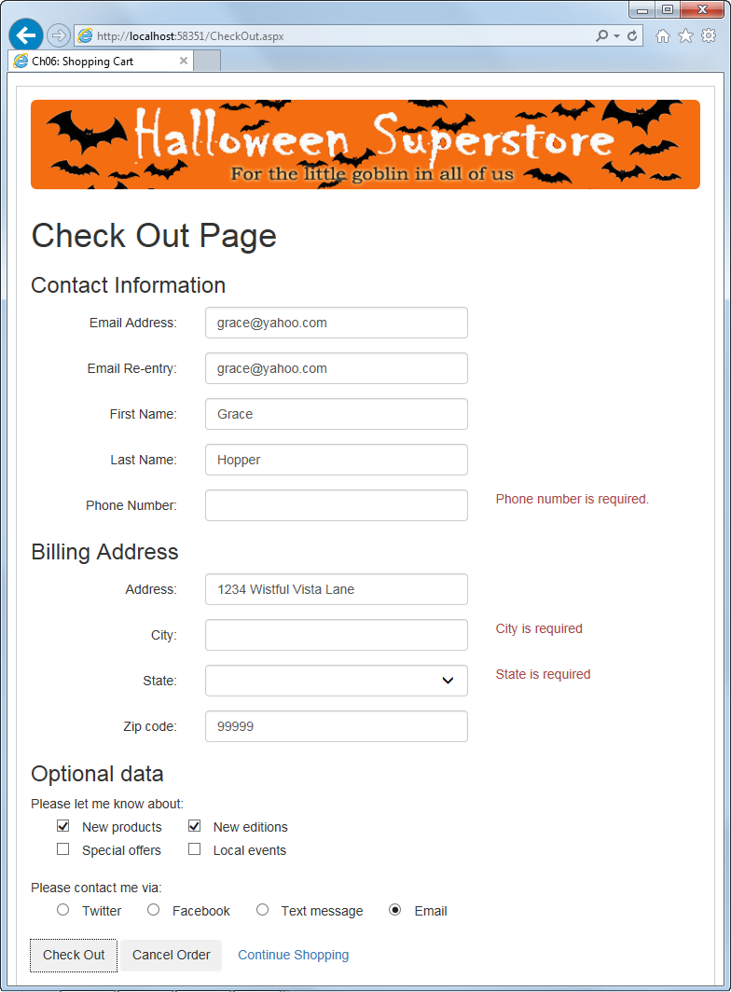
A CheckOut page with standard server controls

Slide 47
The aspx code for the form on the CheckOut page

Slide 48
The aspx code for the CheckOut form (cont.)

Slide 49
The aspx code for the CheckOut form (cont.)

Slide 50
The aspx code for the CheckOut form (cont.)

Slide 51
The aspx code for the CheckOut form (cont.)

Slide 52
The aspx code for the CheckOut form (cont.)

Slide 53
The aspx code for the CheckOut form (cont.)

Slide 54
The aspx code for the CheckOut form (cont.)

Slide 55
The code-behind file for capturing the data

Slide 56
The code-behind file for capturing the data (cont.)

Slide 57
The code-behind file for capturing the data (cont.)

Slide 58
The code-behind file for capturing the data (cont.)

Slide 59
Other standard server controls that you may want to use

Slide 60
jQuery UI widgets that you should be aware of

Slide 61
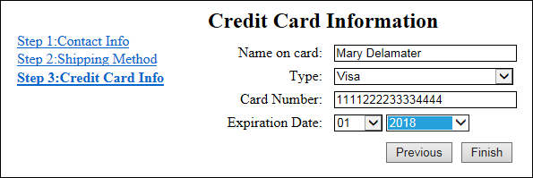
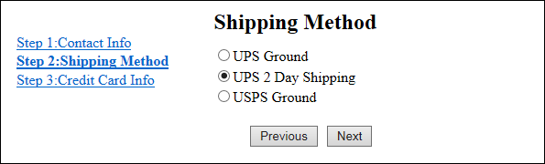
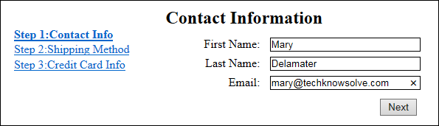
Three steps of a Wizard control

Slide 62
The starting aspx for a Wizard control

Slide 63
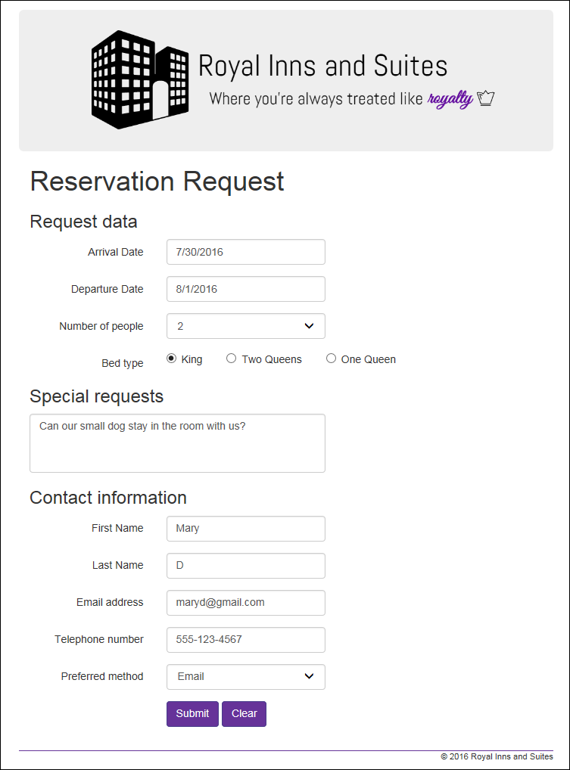
Extra 6-1 Create a Reservation form

